Slide 1




Class Photo
Greedy algorithms
23/07/05

Slide 2
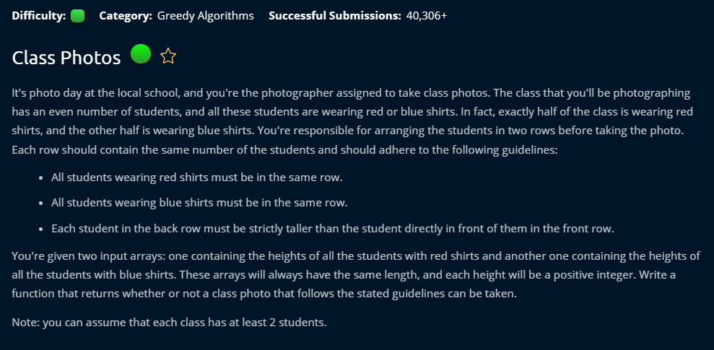

Slide 3


Slide 4


Slide 5


Slide 6


Slide 7


Slide 8


Slide 10
Steps
Compare the tallest students in the groups to decide which group should stay in the front.

Slide 11
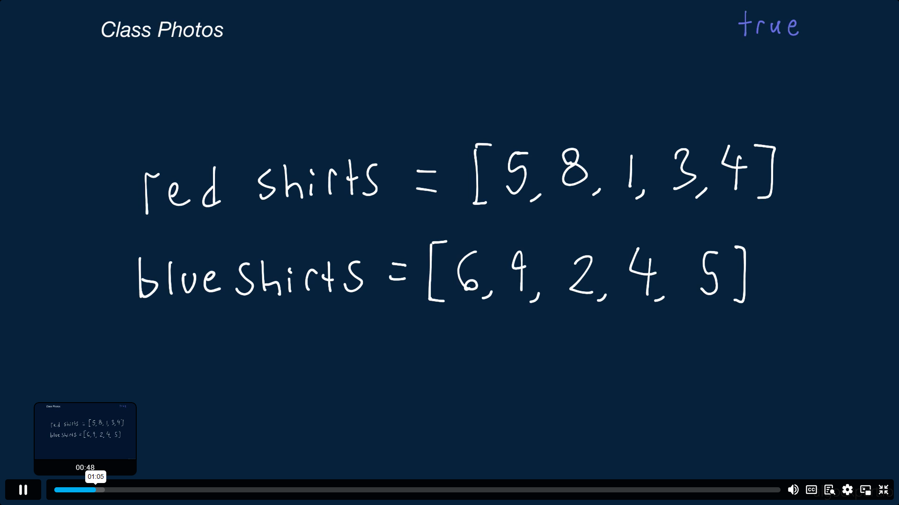

Slide 12
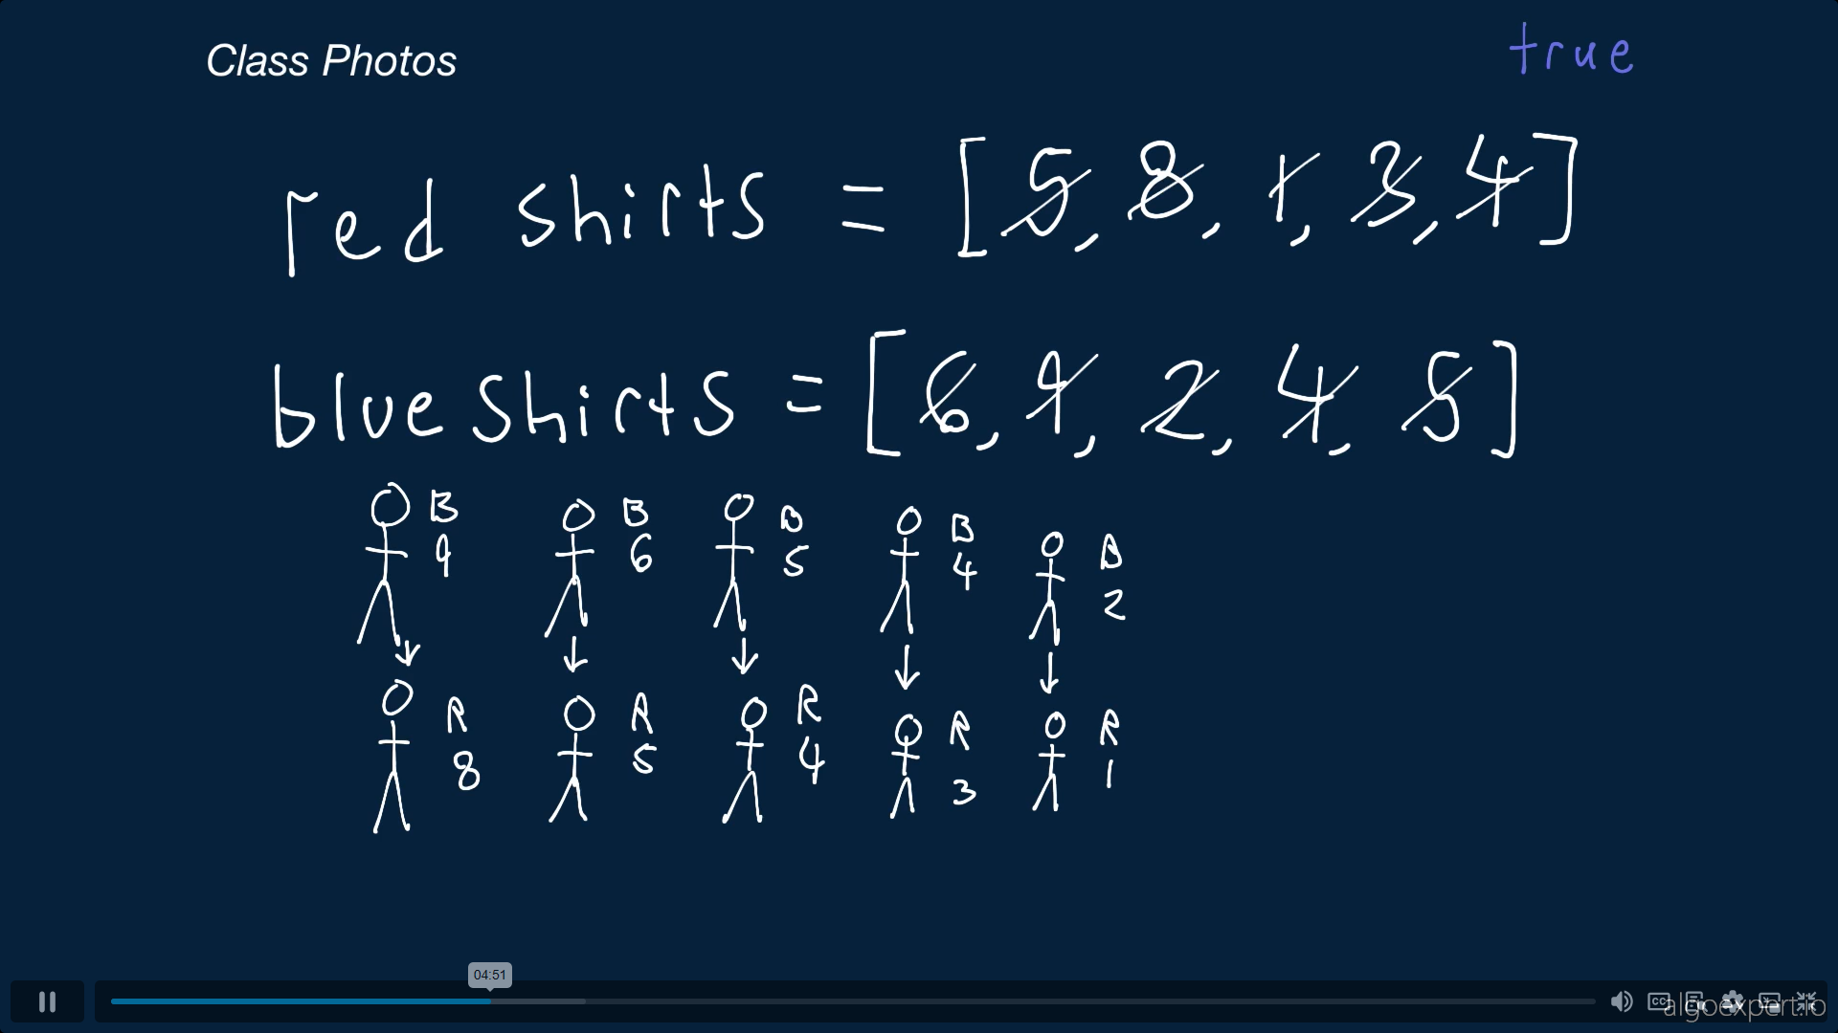

Slide 13
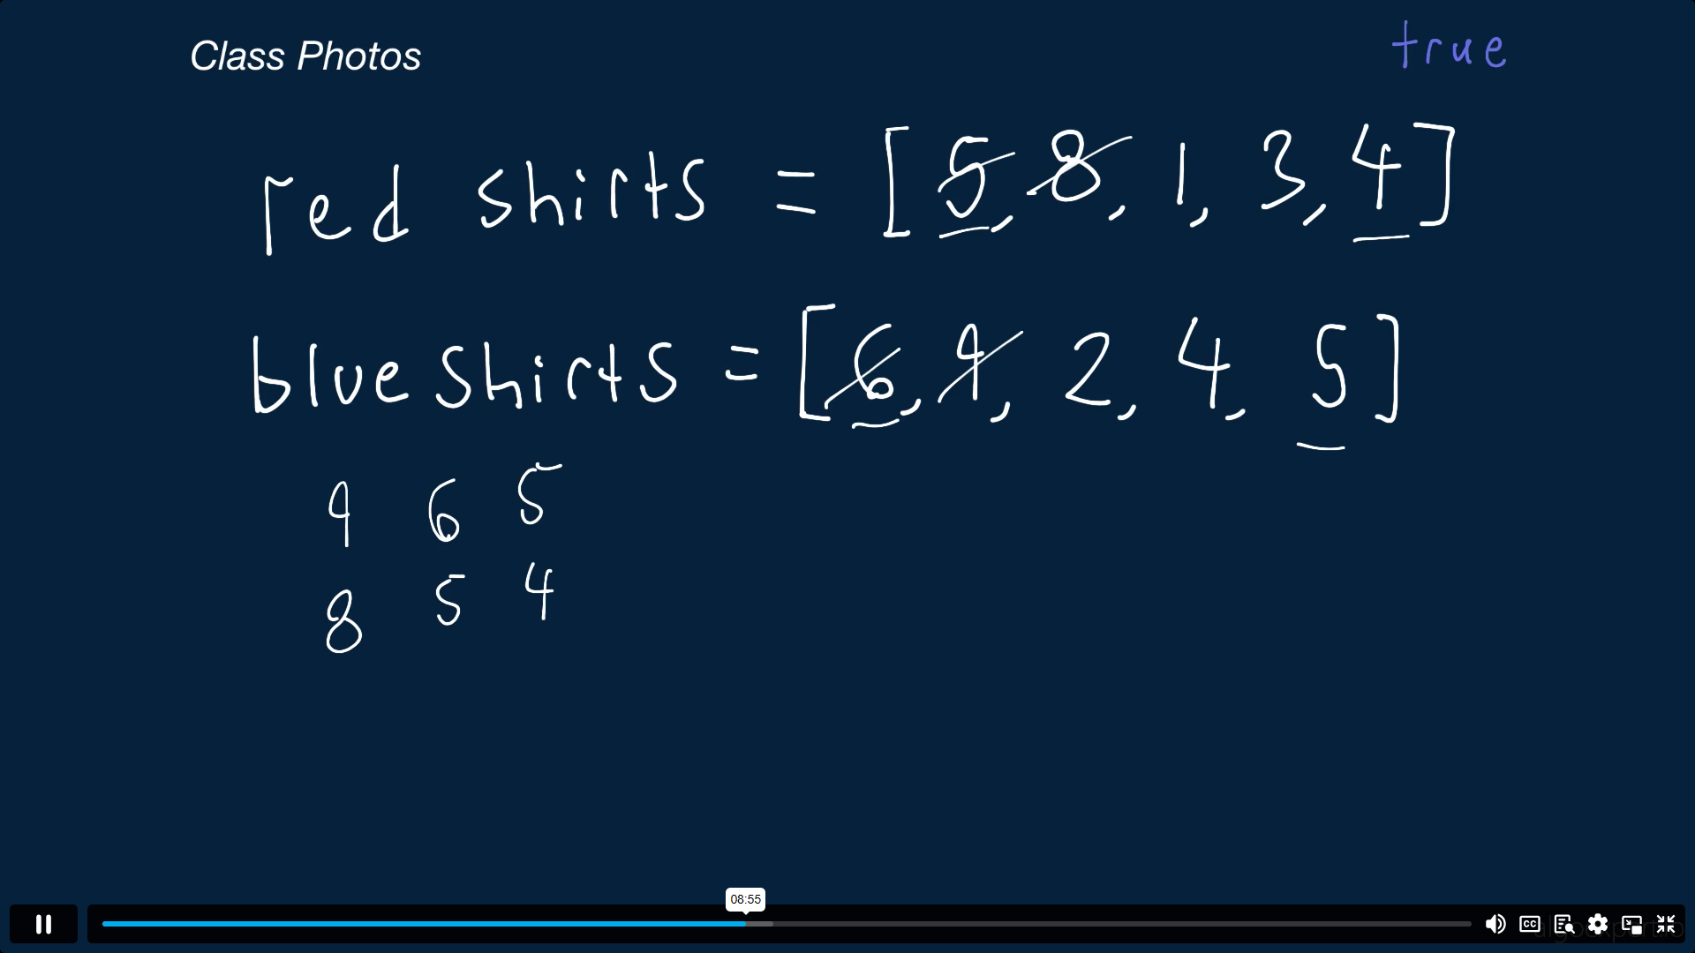

Slide 14
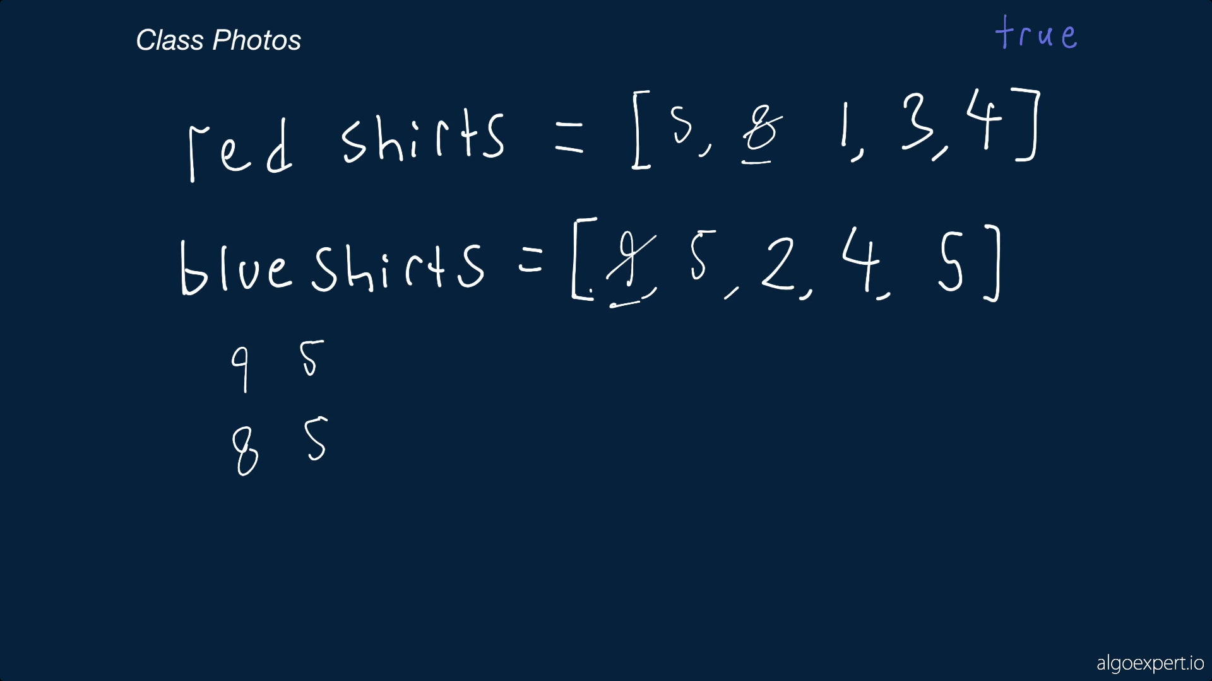

Slide 15
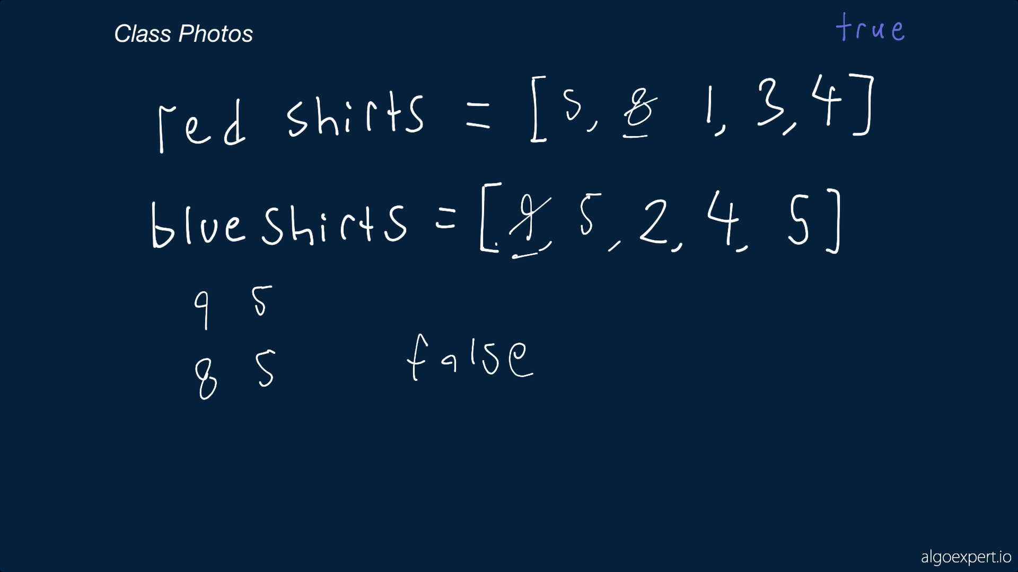

Slide 16
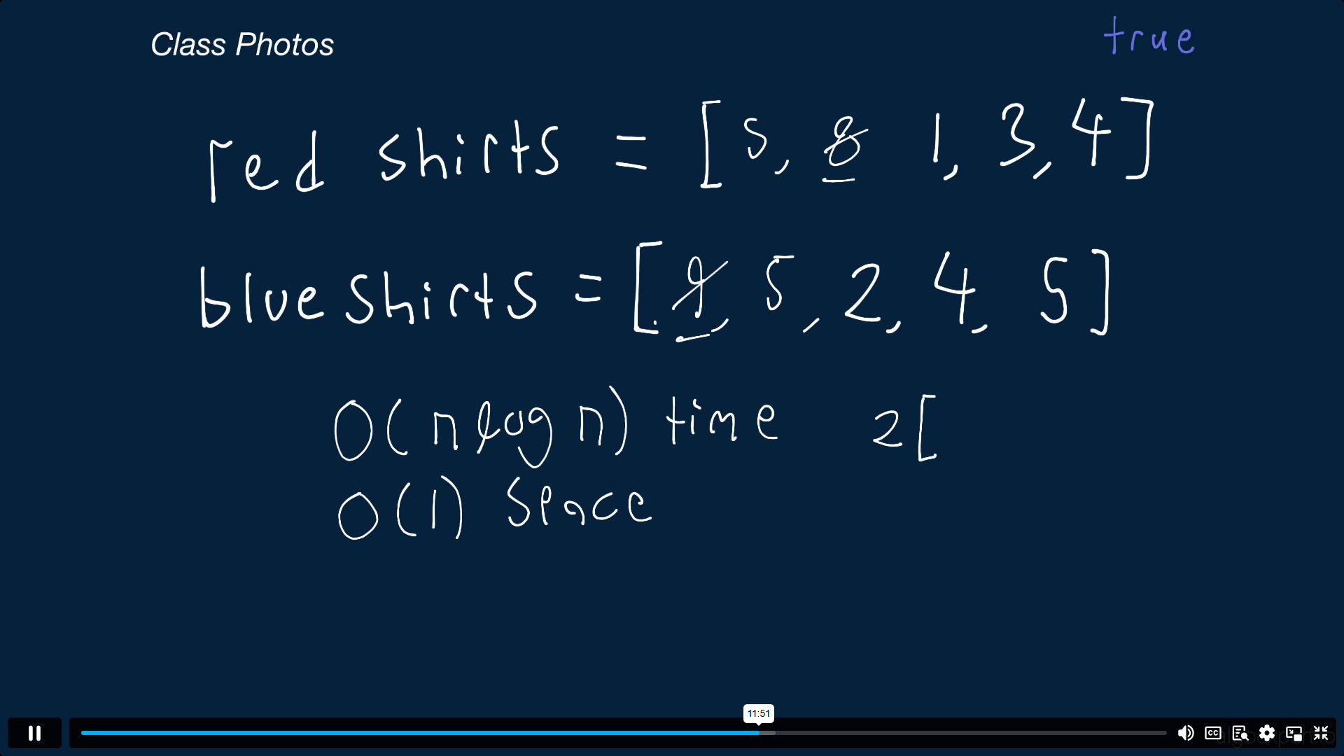

Slide 17
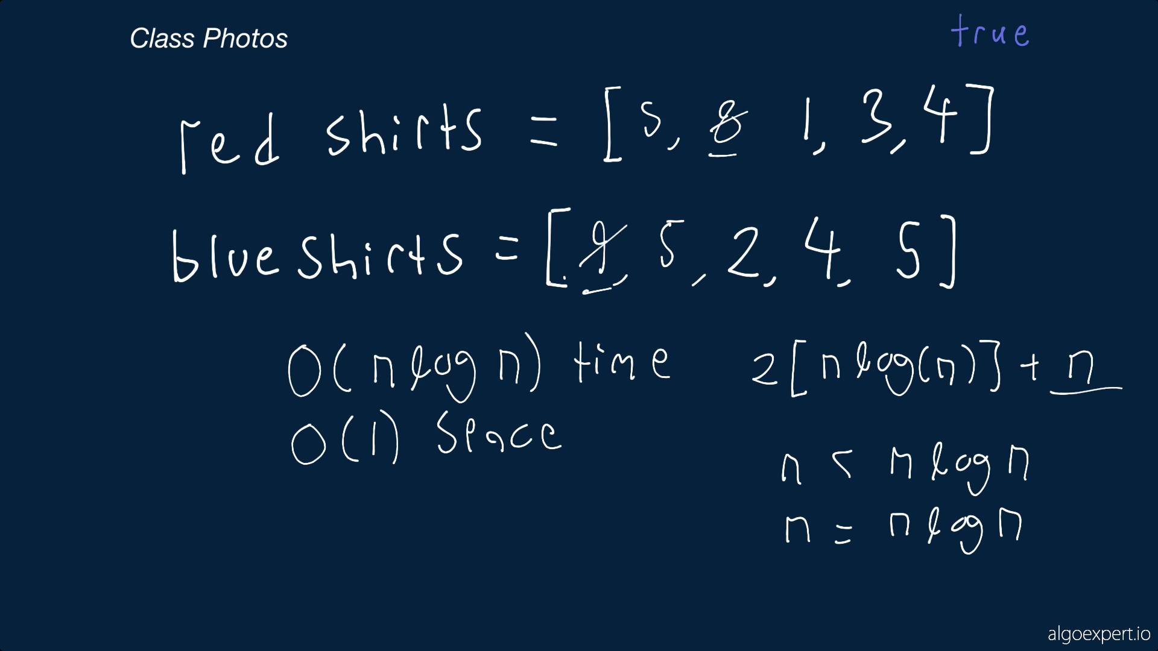

Slide 18
